Slide 1



Client Company
PTHK
Group 5
Network Design Specifications
Kishan Panchal
Siem Tekleweini
Markus Hanna
Harjas Kaur
April 27, 2023

Slide 2

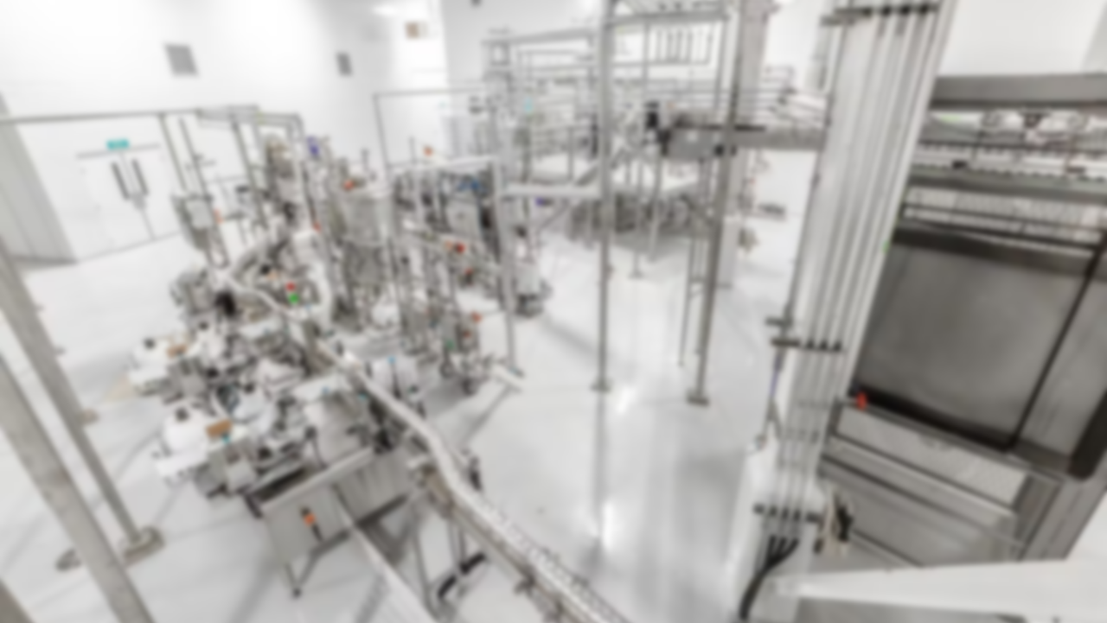
Executive overview
2

Slide 3
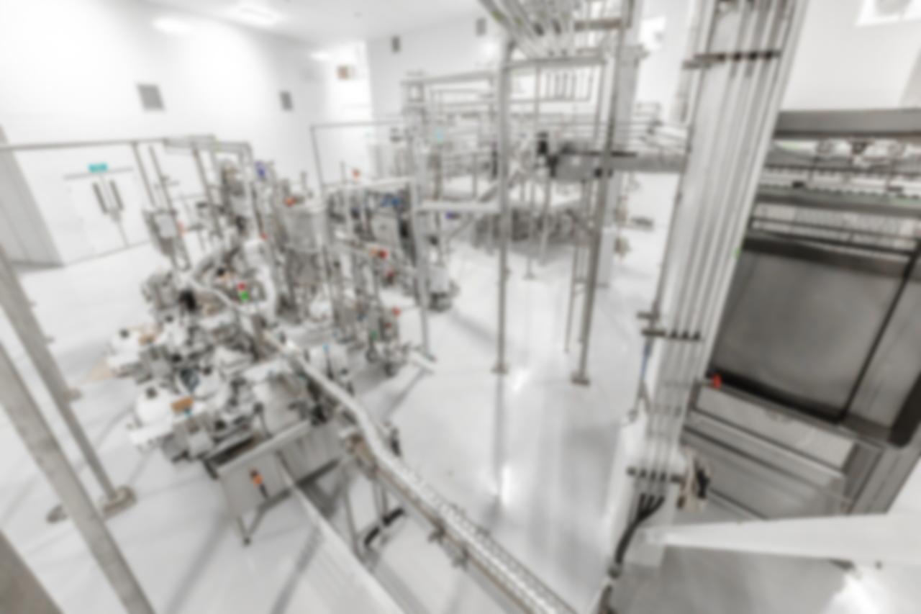
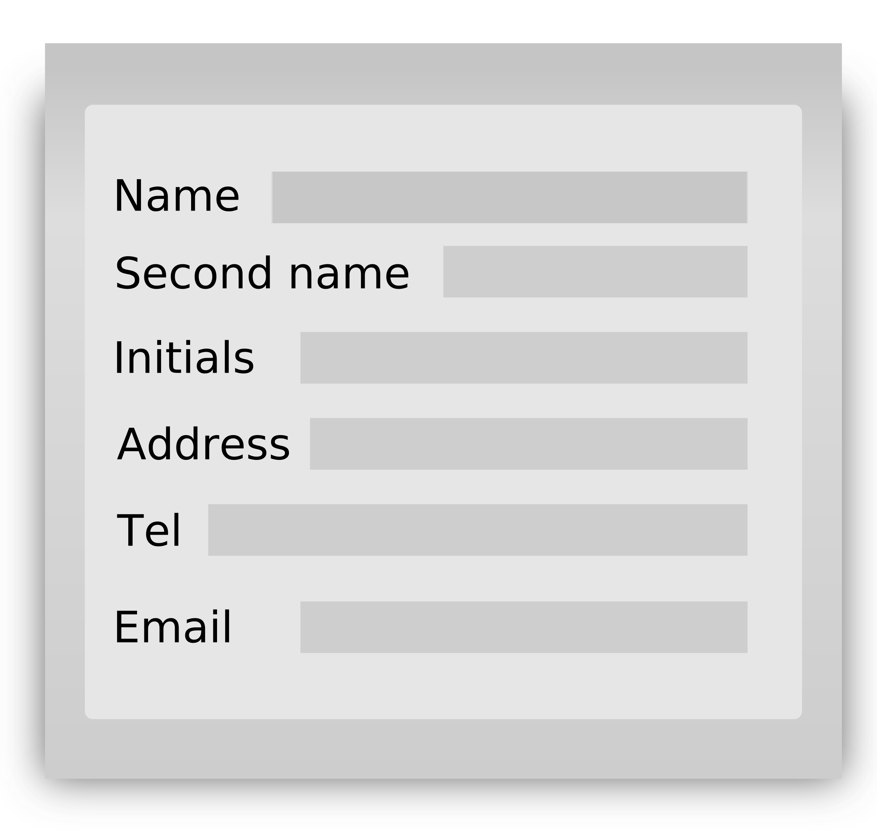
Executive Overview
Client Company consists of a highly focused and energized team with a proven track record in the cannabis and manufacturing industries. As a cannabis processor, Client Company will offer contract manufacturing services and tolling services for the Canadian cannabis market.
The key contact from within the Client Company, who is directly involved in this project is Mr. X(IT Associate).
3

Slide 4
Executive overview
Mr. X Managing Director
Mr. X VP, Quality Assurance
Mr. X VP, Regulatory and Commercial Affairs
Mr. X VP, Human Resources and Global Culture
Mr. X IT Specialist
Mr. X IT Associate
Mr. X VP, Product and Innovation
Mr. X Manager of Scientific Development
4

Slide 5
Executive overview
Requirement Gathering
Logical Design
Physical Design
Installation and Maintenance
Analysis
Determine needs of:
Business
Users
Applications
Network
Estimate and measure traffic and device utilization
Choose technologies that meet the requirements
Apply the Logical Design to the physical space
Implement the Physical Design
Better understanding of the current network.
Facilitate objective decision-making.
Enabling the planning of network migration.
Delivering suitable resources to all users.
5

Slide 6
Executive overview
Requirement Gathering
Logical Design
Physical Design
Installation and Maintenance
Analysis
Determine needs of:
Business
Users
Applications
Network
Estimate and measure traffic and device utilization
Choose technologies that meet the requirements
Apply the Logical Design to the physical space
Implement the Physical Design
Identification of network traffic patterns.
Identification of performance bottlenecks, congestion points or other issues.
Development of a comprehensive network design plan.
Implementation of changes to network’s topology.
6

Slide 7
Executive overview
Requirement Gathering
Logical Design
Physical Design
Installation and Maintenance
Analysis
Determine needs of:
Business
Users
Applications
Network
Estimate and measure traffic and device utilization
Choose technologies that meet the requirements
Apply the Logical Design to the physical space
Implement the Physical Design
Development of a high-level conceptual view of the network.
Definition of network topology, protocols and addressing schemes.
Creation of a flexible and scalable network framework.
7

Slide 8
Executive overview
Requirement Gathering
Logical Design
Physical Design
Installation and Maintenance
Analysis
Determine needs of:
Business
Users
Applications
Network
Estimate and measure traffic and device utilization
Choose technologies that meet the requirements
Apply the Logical Design to the physical space
Implement the Physical Design
Selection of specific hardware and software components.
Determination of their placement and configuration within network.
Consideration of physical constraints.
Detailed documentation of network topology.
Definition of procedures for installation.
8

Slide 9
Executive overview
Requirement Gathering
Logical Design
Physical Design
Installation and Maintenance
Analysis
Determine needs of:
Business
Users
Applications
Network
Estimate and measure traffic and device utilization
Choose technologies that meet the requirements
Apply the Logical Design to the physical space
Implement the Physical Design
Development of physical network components.
Configuration and testing of network.
Ensuring network performance, security, and availability.
Implementation of troubleshooting, upgrades, and backup procedures.
Ensuring the network meets the organization’s needs.
9

Slide 10
Executive overview
Requirement Gathering
Logical Design
Physical Design
Installation and Maintenance
Analysis
Determine needs of:
Business
Users
Applications
Network
Estimate and measure traffic and device utilization
Choose technologies that meet the requirements
Apply the Logical Design to the physical space
Implement the Physical Design
Completed work: up to Phase 4 of Network Design Process
Phase 1: Requirements Gathering Specification document submitted on March 2, 2023
Phase 2 and 3: Analysis of Existing Network completed, and the Specification document submitted on March 30, 2023
Phase 4: Physical Design has completed, and illustrations are presented in the Specification Document
Specification document includes asset list, cost of equipment purchase and labor, project milestones and the hours of work needed for the implementation of network suggetion.
10

Slide 11

Project Review by Phase – Requirements Gathering
11

Slide 12
Project Review by Phase – Requirements Gathering:
Requirement Gathering
Logical Design
Physical Design
Installation and Maintenance
Analysis
Determine needs of:
Business
Users
Applications
Network
Estimate and measure traffic and device utilization
Choose technologies that meet the requirements
Apply the Logical Design to the physical space
Implement the Physical Design
The following techniques were used to collect requirements: a walkthrough and a user survey.
The walkthrough focused on a general overview of the current network infrastructure at the Client Company.
The user survey was conducted using web-forms and was divided into four sections: personal computer, ergonomics, network performance, and security.
The survey was participated by Mr. X (IT Associate), Mr. X (IT Specialist), Mr. X (Business Developer), and a few other members from Client Company.
The project completion date is April 31st, 2023.
12

Slide 13
Project Review by Phase – Requirements Gathering:
Requirement Gathering
Logical Design
Physical Design
Installation and Maintenance
Analysis
Determine needs of:
Business
Users
Applications
Network
Estimate and measure traffic and device utilization
Choose technologies that meet the requirements
Apply the Logical Design to the physical space
Implement the Physical Design
Following information gathered while completing the Requirement Gathering Phase:
50 MB/50 MB powered by MNSI through fiber cabling going through the building
AWS for all services - emailing, Active Directory, and storage servers. Auto backup occurs 3 times a day for entire Microsoft 365 suits and Active Directory by Datto.
Network specifications, details, maintenance reports, and requirements are stored in Excel.
Cisco ASA 5516-X firepower firewall
70 laptops, 3 office printers, 2 label printers, and employees' personal devices.
Dell Inspiron 5000 powered on Windows 10/11 Home, with Logitech wireless mouse & keyboard, Dell S2421NXs @ 60hz monitors, and Bell work cellphones.
Server Rack with Catalyst 9300 48 Port POE Network Essential and Cisco Catalyst 9200L 48 Port POE Network Essential switches, Cisco ASA 5516-X firewall, and UPS and 715 Power Supply for emergencies.
13

Slide 14
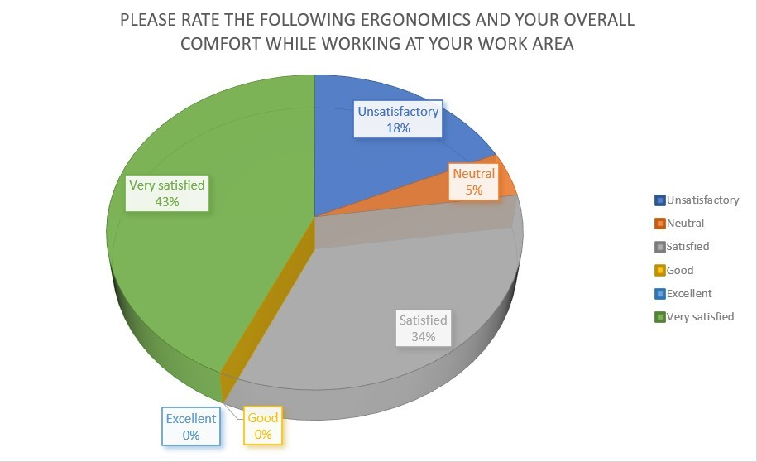
Project Review by Phase – Requirements Gathering:
Requirement Gathering
Logical Design
Physical Design
Installation and Maintenance
Analysis
Determine needs of:
Business
Users
Applications
Network
Estimate and measure traffic and device utilization
Choose technologies that meet the requirements
Apply the Logical Design to the physical space
Implement the Physical Design
The survey results for the ergonomic workspace were compiled in the graph below by Client Company. Many workers are content with the ergonomics and general comfort of their workspace.
14

Slide 15
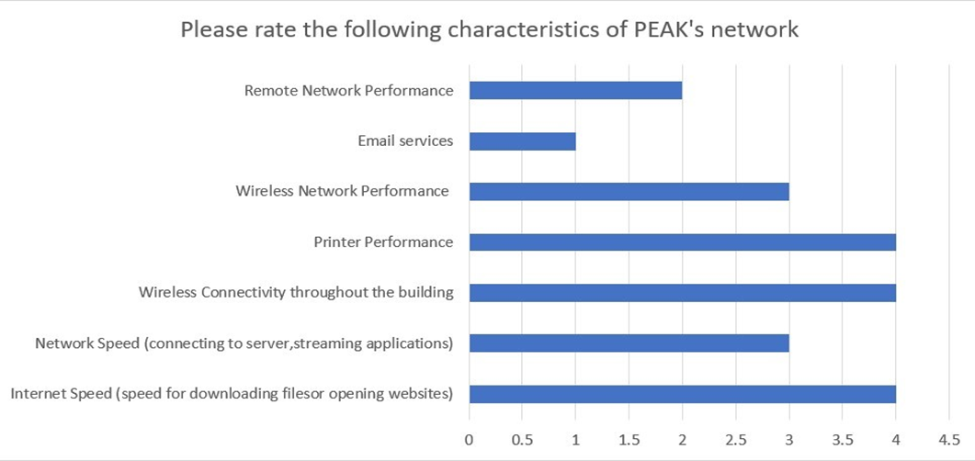
Project Review by Phase – Requirements Gathering:
Requirement Gathering
Logical Design
Physical Design
Installation and Maintenance
Analysis
Determine needs of:
Business
Users
Applications
Network
Estimate and measure traffic and device utilization
Choose technologies that meet the requirements
Apply the Logical Design to the physical space
Implement the Physical Design
The results of the survey taken for the Client Company’s Network were shown in the graph above. The graph demonstrates that there aren't many network-related problems for employees, likewise, wireless network connectivity, its speed, etc. That is why there is a need for wireless network enhancement.
15

Slide 16
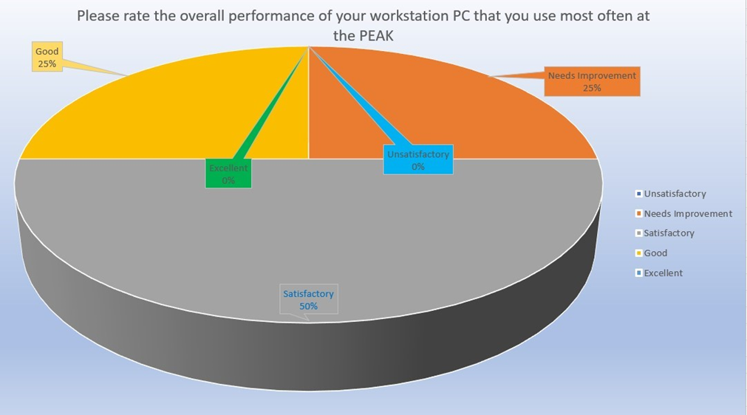
Project Review by Phase – Requirements Gathering:
Requirement Gathering
Logical Design
Physical Design
Installation and Maintenance
Analysis
Determine needs of:
Business
Users
Applications
Network
Estimate and measure traffic and device utilization
Choose technologies that meet the requirements
Apply the Logical Design to the physical space
Implement the Physical Design
Figure displays the results of a survey on the overall performance of employees' workstation PC. The graph indicates that 50% of the workforce is satisfied with PC performance, but there are areas where the PC workstation could be improved.
16

Slide 17
Project Review by Phase – Requirements Gathering:
Requirement Gathering
Logical Design
Physical Design
Installation and Maintenance
Analysis
Determine needs of:
Business
Users
Applications
Network
Estimate and measure traffic and device utilization
Choose technologies that meet the requirements
Apply the Logical Design to the physical space
Implement the Physical Design
Improve Network Backbone – To Gain Wireless Network Speed
The network speed at Client Company is limited to 50 Mbps/50 Mbps, causing delays during high employee activity and when loading large files from the cloud.
17

Slide 18
Project Review by Phase – Requirements Gathering:
Requirement Gathering
Logical Design
Physical Design
Installation and Maintenance
Analysis
Determine needs of:
Business
Users
Applications
Network
Estimate and measure traffic and device utilization
Choose technologies that meet the requirements
Apply the Logical Design to the physical space
Implement the Physical Design
2. Improve Employee Workstation Quality – To Use Latest Software and Reduce Loading Time In A Network
The workstations at Client Company require additional RAM and new components to improve performance, as they take around 40 seconds to display the logon prompt and an additional 30 seconds to become operational from the home screen. Heavy usage of Office 365 and Epicor software is primarily responsible for this delay.
18

Slide 19
Project Review by Phase – Requirements Gathering:
Requirement Gathering
Logical Design
Physical Design
Installation and Maintenance
Analysis
Determine needs of:
Business
Users
Applications
Network
Estimate and measure traffic and device utilization
Choose technologies that meet the requirements
Apply the Logical Design to the physical space
Implement the Physical Design
3. Improve IT Rack Quality – To Manage Network Components Easily with Better Cooling System
The IT Rack at Client Company is insufficiently sized and lacks a proper cooling system to accommodate additional network components and maintain optimal operating levels.
19

Slide 20
Project Review by Phase – Requirements Gathering:
Requirement Gathering
Logical Design
Physical Design
Installation and Maintenance
Analysis
Determine needs of:
Business
Users
Applications
Network
Estimate and measure traffic and device utilization
Choose technologies that meet the requirements
Apply the Logical Design to the physical space
Implement the Physical Design
4. Improve Ergonomics – To Provide Comfortable Workspace to Employees
The current staff desks at Client Company are not adjustable, lack sufficient height, and have limited length, resulting in discomfort for employees who are required to position their workstations in close proximity.
20

Slide 21
Project Review by Phase – Traffic Analysis
21

Slide 22
Project Review by Phase – Traffic Analysis:
Requirement Gathering
Logical Design
Physical Design
Installation and Maintenance
Analysis
Determine needs of:
Business
Users
Applications
Network
Estimate and measure traffic and device utilization
Choose technologies that meet the requirements
Apply the Logical Design to the physical space
Implement the Physical Design
To complete the Traffic Analysis phase, the following techniques were used to contact users and investigate current needs for Client Company:
A meeting was held with Mr. X on March 8th to capture traffic with a span port connected to a laptop with Wireshark and Task Scheduler applications.
900 Megabytes of data was captured for one day with a duration of 7 minutes for every half-an-hour interval, with a total number of packets captured in this period being 6436267.
On March 17th, a Wi-Fi mapping process was carried out at Client Company with Mr. X's guidance, where PTHK measured Wi-Fi signal strengths, connectivity, and speed and conducted a Q&A session to gather more information about Client Company's network requirements.
22

Slide 23
Project Review by Phase – Traffic Analysis:
Requirement Gathering
Logical Design
Physical Design
Installation and Maintenance
Analysis
Determine needs of:
Business
Users
Applications
Network
Estimate and measure traffic and device utilization
Choose technologies that meet the requirements
Apply the Logical Design to the physical space
Implement the Physical Design
Following information gathered while completing the Traffic Analysis Phase:
Traffic estimates for specific applications: 0.144 Mbps for E-Mail, 12 Mbps for FTP Server, and 4.8 Mbps for Security Cameras
Internet speed for wired and wireless connections is not good enough, with 50 Mb/50 Mb provided by MNSI through fiber cabling going through the building.
Dell Inspiron 5000 running Windows 10 Home is not suitable for some advanced features of Windows 10 Pro, such as virtual machines. RAM is also an issue with workstations having only 8 GBs of RAM, while employees use Office 365 suits and Epicor together leading to more RAM and CPU utilization.
Network traffic mainly consists of multicast addresses rather than broadcast.
Packets with length between 1280 to 2559 cover around 45% of the network traffic based on frame distribution.
23

Slide 24
Project Review by Phase – Traffic Analysis:
Application | % Distribution per Segment | # of Simultaneous Sessions | Average Transaction Size | Estimated Total Capacity Required
E-Mail | 100% | 0.09 | 200KB | 0.144Mbps
FTP Server | 100% | 1 | 1500KB | 12Mbps
Security Cameras | 100% | 0.75 | 800KB | 4.8Mbps
 |  |  | Totals | 16.944Mbps
Step 1: Determine the Average Transaction Size and Number of Simultaneous Sessions per second.
ATS for Office 365 E-mail = 200KB Sessions per Second = 0.09
Step 2: Multiply these two values together to determine the estimated bandwidth requirements per second.
200KB x 0.09/second = 18KB/second
Step 3: Convert KB (Kilobytes)/second to Kb (Kilobits/second)
18KB/s x 8 = 144Kb/sec
Step 4: Convert Kb per second into Mb per second, (division by 1000 is sufficient for estimation purposes).
144Kbps ÷ 1000 = 0.144Mbps
Step 5: The approximate bandwidth requirement for a network is the total estimated capacity of all applications.
0.144Mbps + 12 Mbps + 4.8 Mbps = 16.944 Mbps
24

Slide 25
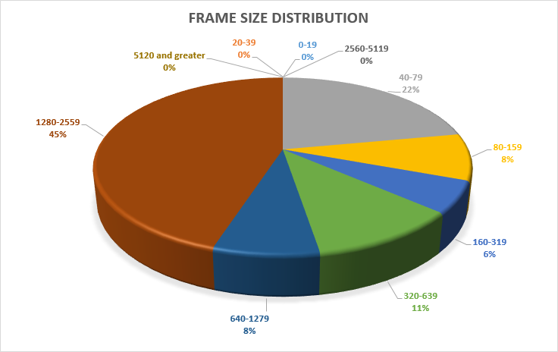
Project Review by Phase – Traffic Analysis:
Requirement Gathering
Logical Design
Physical Design
Installation and Maintenance
Analysis
Determine needs of:
Business
Users
Applications
Network
Estimate and measure traffic and device utilization
Choose technologies that meet the requirements
Apply the Logical Design to the physical space
Implement the Physical Design
The graph displays the distribution of packet sizes in the network, with the largest percentage of transmitted packets falling between 1280-2559 bytes.
25

Slide 26
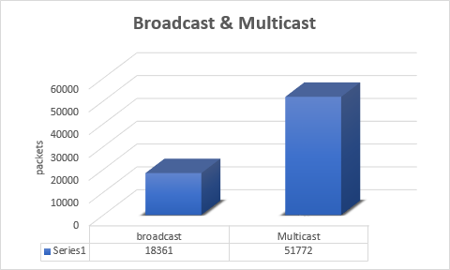
Project Review by Phase – Traffic Analysis:
Requirement Gathering
Logical Design
Physical Design
Installation and Maintenance
Analysis
Determine needs of:
Business
Users
Applications
Network
Estimate and measure traffic and device utilization
Choose technologies that meet the requirements
Apply the Logical Design to the physical space
Implement the Physical Design
Broadcast is used to send the same data to all devices, while multicast is used to send the same data to a specific group of devices. 18,361 broadcast packets were sent and 51772 multicast packets were broadcasted.
26

Slide 27
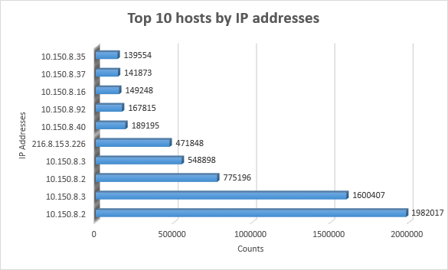
Project Review by Phase – Traffic Analysis:
Requirement Gathering
Logical Design
Physical Design
Installation and Maintenance
Analysis
Determine needs of:
Business
Users
Applications
Network
Estimate and measure traffic and device utilization
Choose technologies that meet the requirements
Apply the Logical Design to the physical space
Implement the Physical Design
Host 10.150.8.2 is responsible for the most data transmission/receiving across the network.
27

Slide 28
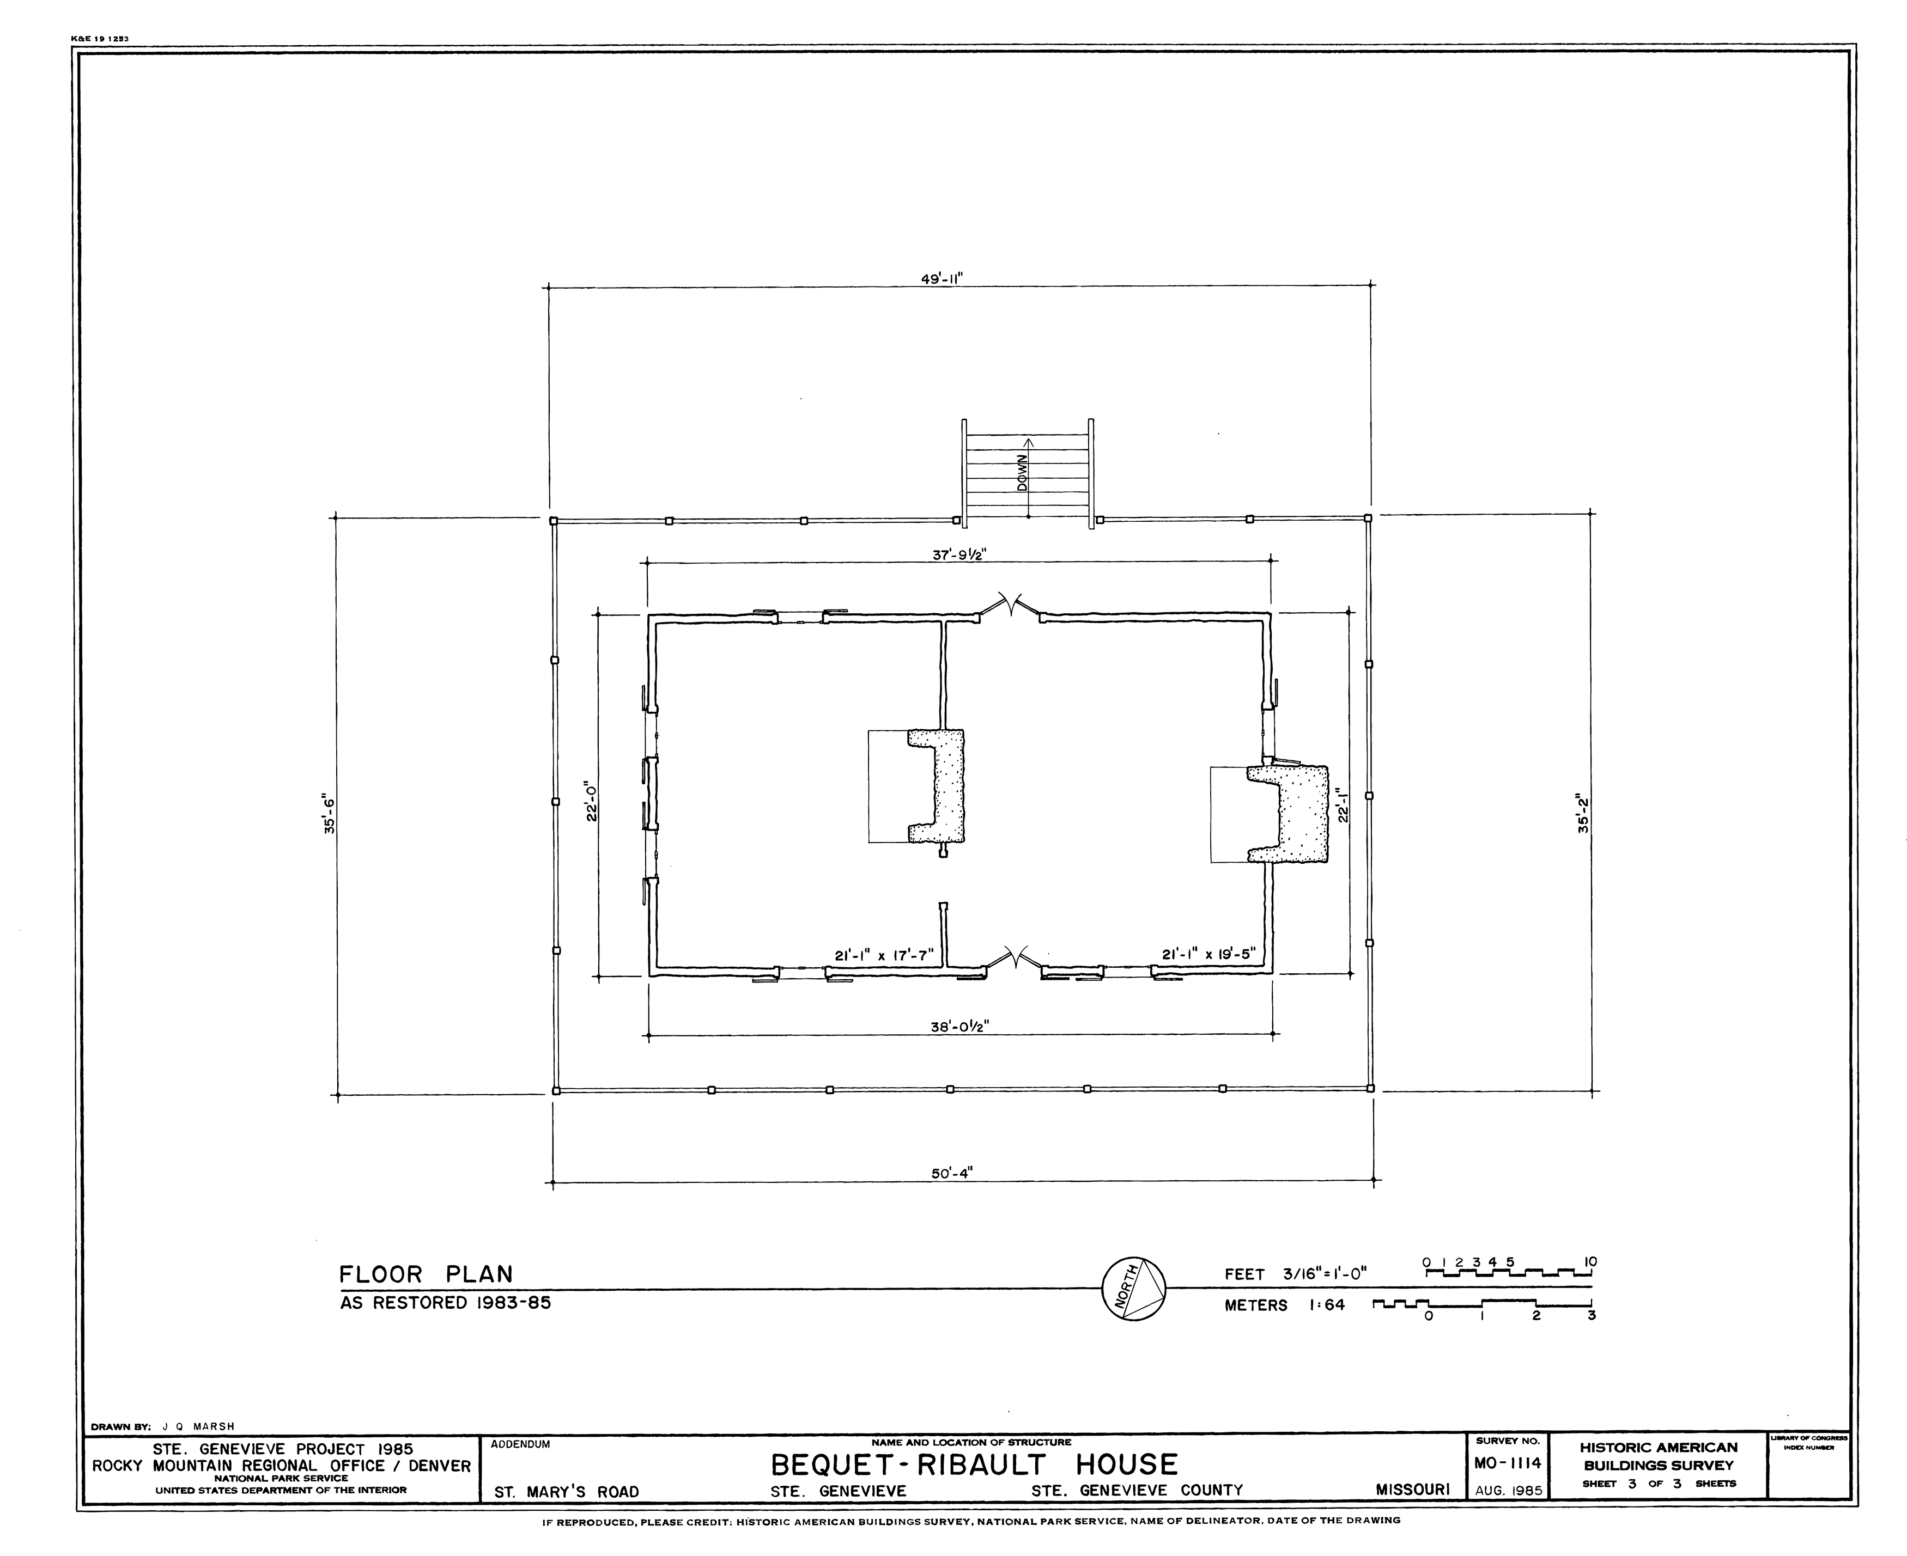
Project Review by Phase – Traffic Analysis:
Requirement Gathering
Logical Design
Physical Design
Installation and Maintenance
Analysis
Determine needs of:
Business
Users
Applications
Network
Estimate and measure traffic and device utilization
Choose technologies that meet the requirements
Apply the Logical Design to the physical space
Implement the Physical Design
Insufficient network speed and improper AP placement are contributing factors to Client Company network issues.
This Photo by Unknown Author is licensed under CC BY-SA
28

Slide 29
Project Review by Phase – Logical Design
29

Slide 30
Project Review by Phase – Logical Design:
Requirement Gathering
Logical Design
Physical Design
Installation and Maintenance
Analysis
Determine needs of:
Business
Users
Applications
Network
Estimate and measure traffic and device utilization
Choose technologies that meet the requirements
Apply the Logical Design to the physical space
Implement the Physical Design
As mentioned earlier in this phase, the detailed network design is created, including the selection of hardware and software components and the creation of network diagrams.
Logical Diagram
Revised Logical Diagram
30

Slide 31
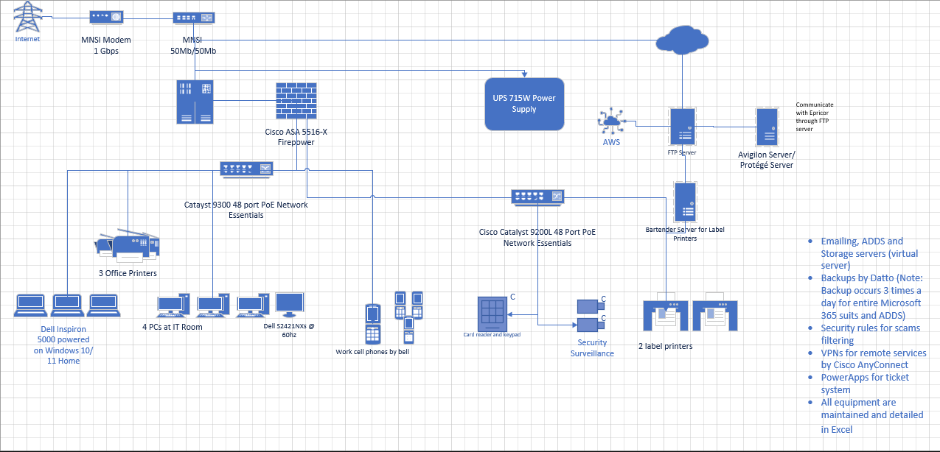
31

Slide 32
32

Slide 33
33

Slide 34
34

Slide 35
35

Slide 36
36

Slide 37
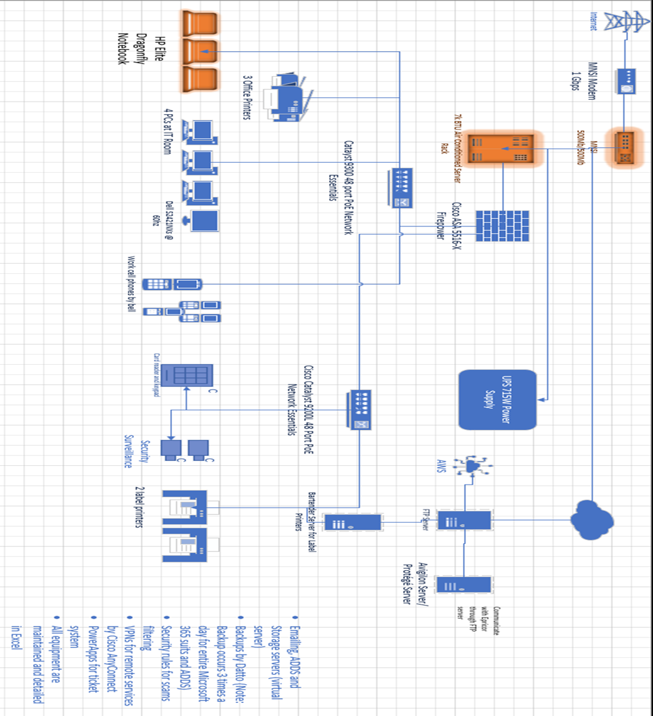
37

Slide 38
38

Slide 39
39

Slide 40
40

Slide 41
41

Slide 42
42

Slide 43


Project Review by Phase – Logical Design:
1. Upgrade Wi-Fi Router – To Increase Wireless Network Speed
Option 1A | Option 1B
MNSi for Business | Gigabit Business Fibe
500/500 Mbps Fibe Internet | 940/940 Mbps
Unlimited monthly Usage, Static IP address included, and 3-Year Contract. | Unlimited monthly Usages, Bell Protection, 3-Year term plan.
Product | Quantity | Price | Total Price
MNSi for Business | 1 | $125.00 | $125.00
Gigabit Business Fibe | 1 | $94.95* | $94.95
43

Slide 44

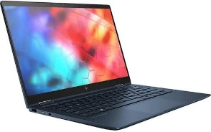
Project Review by Phase – Logical Design:
2. Upgrade Workstation – To Increase Overall Performance and Functionality
Option 2A | Option 2B
HP Elite Dragonfly Notebook | Lenovo ThinkPad X1 Carbon
CPU: Intel Core i7 8th Gen OS: Windows 10 Pro RAM: 16 GB LPDDR3 Storage: 256 GB SSD | CPU: Intel Core i7 7th Gen OS: Windows 10 Pro RAM: 16 GB Storage: 1 TB SSD
Product | Quantity | Price | Total Price
HP Elite Dragonfly Notebook | 70 | $3053.38 | $213,736.60
Lenovo ThinkPad X1 Carbon | 70 | $4057.78 | $284,044.60
44

Slide 45
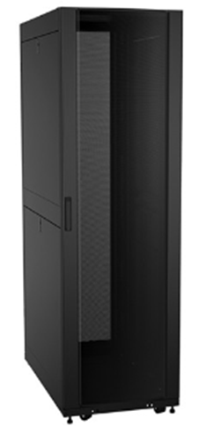
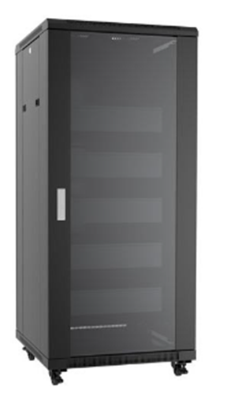
Project Review by Phase – Logical Design:
3. Upgrade Server Rack – To Improve Cooling and System Stability
Option 3A | Option 3B
7k BTU Air-Conditioned Server Rack | Rb-Av42 42U 24D Audio-Visual Cabinet
Rack Units: 42 Cooling Capacity: 7000 BTU (2.0 kW) Noise Level: 57 dbA Door: Vented Door | Rack Units: 42 Cooling Capacity: NA Door: Glass Door
Product | Quantity | Price | Total Price
7k BTU Air-Conditioned Server Rack | 1 | $3857.58 | $3857.58
Rb-Av42 42U 24D Audio-Visual Cabinet | 1 | $2142.86 | $2142.86
45

Slide 46
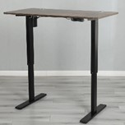
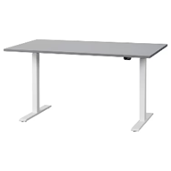
Project Review by Phase – Logical Design:
4. Upgrade Staff Desk – To Improve Work Area Ergonomics
Option 4A | Option 4B
Altamae 48” Adjustable Height Standing Desk | RODULF Desk sit/stand
Additional 5-year Protection Plan for $48.99 Width: 48” Warranty: 3 Years Weight Capacity: 180 lb Material: Metal | Length: 56” Width: 32.5“ Weight Capacity: 154 lb Color Option: Gray/White
Product | Quantity | Price | Total Price
Altamae 48” Adjustable Height Standing Desk | 50 | $296.99 | $14,849.50
RODULF Desk sit/stand | 50 | $429.00 | $21,450.00
46

Slide 47
Project Review by Phase – Physical Design
47

Slide 48
Project Review by Phase – Physical Design:
Requirement Gathering
Logical Design
Physical Design
Installation and Maintenance
Analysis
Determine needs of:
Business
Users
Applications
Network
Estimate and measure traffic and device utilization
Choose technologies that meet the requirements
Apply the Logical Design to the physical space
Implement the Physical Design
Now, in this phase, the network design is put into action through installation, configuration, and testing of the network components.
During this phase, the project plan will include several important components, including an asset list outlining all necessary resources, a Gantt chart illustrating project milestones, an implementation Gantt chart detailing project tasks and timelines, a cost analysis, and a revised physical design plan.
48

Slide 49
 | Asset List - Client Company – April 2023
Device | Model | Quantity | Location | Serial # | Comments
New Items – To Be Purchased
Routerr | MNSi for Business | 1 | Hallway
Laptops | HP Elite Dragonfly Notebook | 70 | Plant Wide
IT RACK | 7k BTU Air-Conditioned Server Rack | 1 | Server Room
Staff Desk | Altamae 48” Adjustable Height Standing Desk | 50 | Plant Wide
Existing Technology – To Be Re-Used
Switches | Cisco Catalyst 9200L 48 Port PoE | 2 | Sever Room
Firewall | Cisco ASA 5516-X | 1 | Server Room
UPS | 715W Power supply | 1 | Server Room
Monitors | Dell S2421NXs @ 60hz | 20 | Plant Wide
Keyboard | Logitech | 20 | Plant Wide
Mouse | Logitech | 20 | Plant Wide
Printers | Label Printers | 2 | Production Area
 | Office Printers | 3 | Plant Wide
Cat 5e Cable | Various Manufacturers | All | Plant Wide
Fiber Cable | Various Manufacturers | All | Plant Wide
Existing Items – To Be Discarded
Laptops | Dell Inspiron 5000 | 70 | Plant Wide |  | Return on lease
49

Slide 50
 | Asset List - Client Company – April 2023
Device | Model | Quantity | Location | Serial # | Comments
New Items – To Be Purchased
Routerr | MNSi for Business | 1 | Hallway
Laptops | HP Elite Dragonfly Notebook | 70 | Plant Wide
IT RACK | 7k BTU Air-Conditioned Server Rack | 1 | Server Room
Staff Desk | Altamae 48” Adjustable Height Standing Desk | 50 | Plant Wide
Existing Technology – To Be Re-Used
Switches | Cisco Catalyst 9200L 48 Port PoE | 2 | Sever Room
Firewall | Cisco ASA 5516-X | 1 | Server Room
UPS | 715W Power supply | 1 | Server Room
Monitors | Dell S2421NXs @ 60hz | 20 | Plant Wide
Keyboard | Logitech | 20 | Plant Wide
Mouse | Logitech | 20 | Plant Wide
Printers | Label Printers | 2 | Production Area
 | Office Printers | 3 | Plant Wide
Cat 5e Cable | Various Manufacturers | All | Plant Wide
Fiber Cable | Various Manufacturers | All | Plant Wide
Existing Items – To Be Discarded
Laptops | Dell Inspiron 5000 | 70 | Plant Wide |  | Return on lease
50

Slide 51
 | Asset List - Client Company – April 2023
Device | Model | Quantity | Location | Serial # | Comments
New Items – To Be Purchased
Routerr | MNSi for Business | 1 | Hallway
Laptops | HP Elite Dragonfly Notebook | 70 | Plant Wide
IT RACK | 7k BTU Air-Conditioned Server Rack | 1 | Server Room
Staff Desk | Altamae 48” Adjustable Height Standing Desk | 50 | Plant Wide
Existing Technology – To Be Re-Used
Switches | Cisco Catalyst 9200L 48 Port PoE | 2 | Sever Room
Firewall | Cisco ASA 5516-X | 1 | Server Room
UPS | 715W Power supply | 1 | Server Room
Monitors | Dell S2421NXs @ 60hz | 20 | Plant Wide
Keyboard | Logitech | 20 | Plant Wide
Mouse | Logitech | 20 | Plant Wide
Printers | Label Printers | 2 | Production Area
 | Office Printers | 3 | Plant Wide
Cat 5e Cable | Various Manufacturers | All | Plant Wide
Fiber Cable | Various Manufacturers | All | Plant Wide
Existing Items – To Be Discarded
Laptops | Dell Inspiron 5000 | 70 | Plant Wide |  | Return on lease
51

Slide 52
 | Asset List - Client Company – April 2023
Device | Model | Quantity | Location | Serial # | Comments
New Items – To Be Purchased
Routerr | MNSi for Business | 1 | Hallway
Laptops | HP Elite Dragonfly Notebook | 70 | Plant Wide
IT RACK | 7k BTU Air-Conditioned Server Rack | 1 | Server Room
Staff Desk | Altamae 48” Adjustable Height Standing Desk | 50 | Plant Wide
Existing Technology – To Be Re-Used
Switches | Cisco Catalyst 9200L 48 Port PoE | 2 | Sever Room
Firewall | Cisco ASA 5516-X | 1 | Server Room
UPS | 715W Power supply | 1 | Server Room
Monitors | Dell S2421NXs @ 60hz | 20 | Plant Wide
Keyboard | Logitech | 20 | Plant Wide
Mouse | Logitech | 20 | Plant Wide
Printers | Label Printers | 2 | Production Area
 | Office Printers | 3 | Plant Wide
Cat 5e Cable | Various Manufacturers | All | Plant Wide
Fiber Cable | Various Manufacturers | All | Plant Wide
Existing Items – To Be Discarded
Laptops | Dell Inspiron 5000 | 70 | Plant Wide |  | Return on lease
52

Slide 53
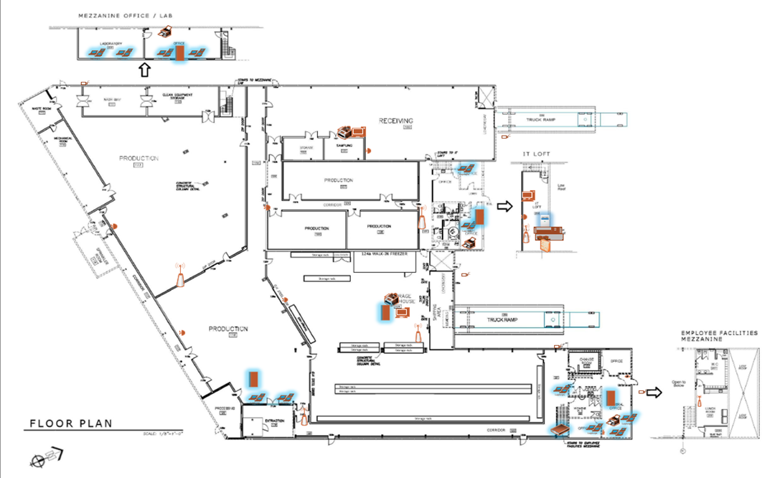
53

Slide 54
54

Slide 55


55

Slide 56
56

Slide 57
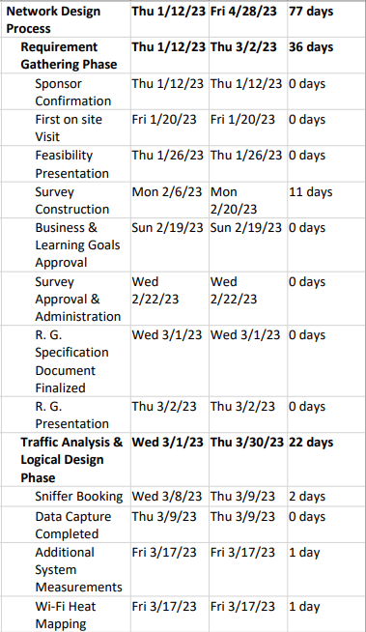
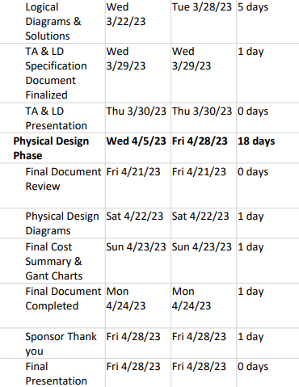
57

Slide 58
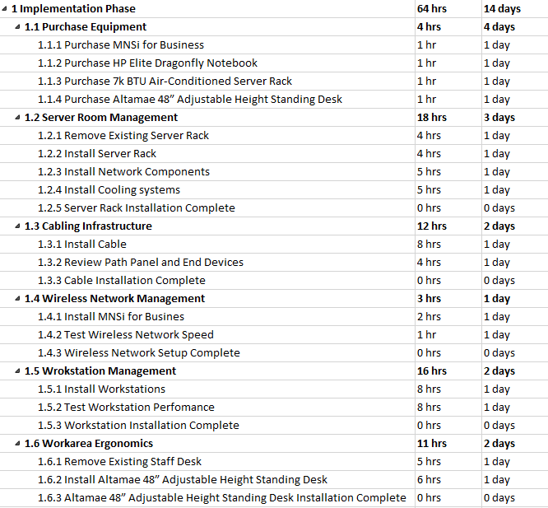
58

Slide 59
Project Review by Phase – Physical Design:
Equipment Cost Analysis
Labor Cost Analysis
Option | Product | Price | Units | Subtotal
1A | MNSi for Business | $125.00 | 1 | $125.00
2A | HP Elite Dragonfly Notebook | $3053.38 | 70 | $213,736.60
3A | 7k BTU Air-Conditioned Server Rack | $3857.58 | 1 | $3,857.58
4A | Altamae 48” Adjustable Height Standing Desk | $296.99 | 50 | $14,849.50
 |  | Sub Total |  | $2,32,568.68
 |  | HST 13% |  | $30,233.93
 |  | Total |  | $2,62,802.61
Option | Hours | Price
1A | 4 | $400.00
2A | 17 | $1,700.00
3A | 31 | $3,100.00
4A | 12 | $1,200.00
 | Sub Total | $6,400.00
 | HST 13% | $832.00
 | Total | $7,232.00
Total Cost Summary
Item (Including Taxes) | Price
Equipment Cost | $2,62,802.61
Labor Cost | $7,232.00
Grand Total | $2,70,034.61
59

Slide 60
Client Company
PTHK
Group 5
Thank You
60

